Slide 1

CENG519 Project Presentation
UDP Checksum
Covert Channel and its Detection
Bartu Akyürek
2594109
June 2025
Notes:
Hello, welcome, I’m bartu.
This project is about embedding covert data within the checksum field of UDP packets.

Slide 2
Background
Embedding covert data within the checksum field of UDP packets.
32 bits
Source Port
Destination Port
Length
UDP Checksum
Data
UDP Segment Structure
Notes:
Here is a UDP segment, our aim is to somehow embed hidden data within the checksum field.

Slide 3
Background
Fisk et. al [1]
existence of checksum field
32 bits
Source Port
Destination Port
0
Length
UDP Checksum
Data
1
covert bit
UDP Segment Structure
Notes:
But, how are we going to do this?
Fisk et al. describes covert bits can be embedded as a *flag* in UDP checksum field.
That means, the existence of Checksum field itself is the covert bit.
If Checksum is provided, it indicates 1
If Checksum is not provided, then indicates covert bit of 0.
So we’ll use the very existence of checksum field to transmit a covert bit of either 0 or 1 within a single packet.

Slide 4


Implementation
“Hello, this is a long message. Hello, this is a long message. Hello, this is a long message. Hello, this is a long message. Hello, this is a long message. Hello, this is a long message. Hello, this is a long message. Hello, this is a long message. ”
sec
insec
carrier message
[1]Hello [2], thi [3]s is [4]a lon [5]g mes [6]sage. [7] Hell [8]o, th [9]is i [10]s a l [13]messa [14]ge. H [15]ello, [16] this [17] is a [18]long [19]messa [20]ge.
0
1
1
0
1
0
0
0
1
1
1
1
0
1
0
0
1
0
1
0
covert bits
Notes:
When it comes to implementation
Let’s say the secure channel wants to send this long message to insecure channel.
If it sends the entire message within a single packet, it will only send a single bit of covert data.
Because our implementation allows transmitting only 1 bit of covert data per packet.
What we’re going to do instead, we’ll split this carrier message into smaller packets with a sequence number
That way we’re able to send a chunk of covert data within a single session.

Slide 5
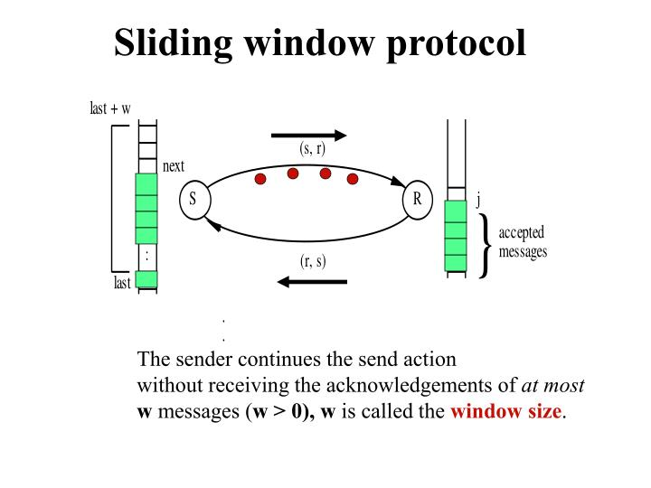
Implementation
Input parameters
window_size = 5
tranmission = 1
timeout = 0.5
Notes:
We’re using UDP, our packets can get lost, we need to ensure the covert bits are actually received.
To ensure a reliable transfer over UDP, we’ll employ sliding window protocol.
We’ll use multi-threading to fire multiple packets out of order, and slide the window as we receive acknowledgements.
Receiver will send an ACK by sending the sequence number of the received packet back to the sender.
For the experiments, we’ll have 3 input parameters.
One is the window size, telling how many packets are sent simultaneously without receiving the ACKs.
The other is the number of transmissions of the same packet. If a packet is not received within a timeframe, we’ll retransmit this packet until its acknowledgement arrives,
or we reached maximum transmission count. That means if a packet for some reason, never returns an ACK we’ll not get stuck on that packet and continue our transmission.
We may or may not receive the remaining ACKs later on.
The last parameter is timeout, telling how many seconds to wait before retransmitting or sliding the window to the next pending packet.

Slide 6


Implementation
sec
insec
overt
covert
“01010011001100011001010100111010100101”
preamble
length
actual data
covert data
Notes:
We’ll have two communication phases. One is overt, that is supposed to be the normal traffic. Then there’s covert phase.
Once we transition from overt to covert phase, we append a preamble before the actual covert data, that is a specific pattern, telling the receiver “hey I’m about to send covert data”.
Both sender and receiver agrees upon this preamble string beforehand.
Once receiver recognizes the preamble, it is ready to save the covert data bits.
We also append the length of the actual covert data so that the receiver knows when to switch back to overt phase.

Slide 7
Implementation
sec
insec
overt
covert
“1000001100010101001001010100101”
random checksum
Notes:
In addition, to decrease detectability of this channel,
in overt state, we’re going to use checksum field randomly.
So in the overt state, some checksums will be 0, some will be non-zero just like how it is in the covert state.
This effectively hides the difference between covert and overt states on surface.

Slide 8
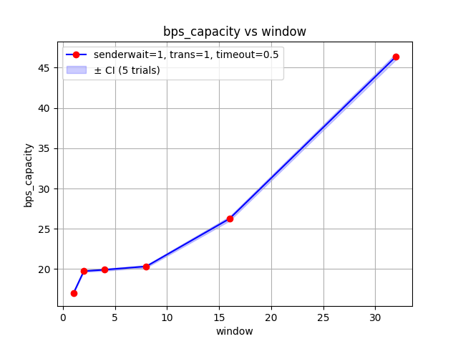
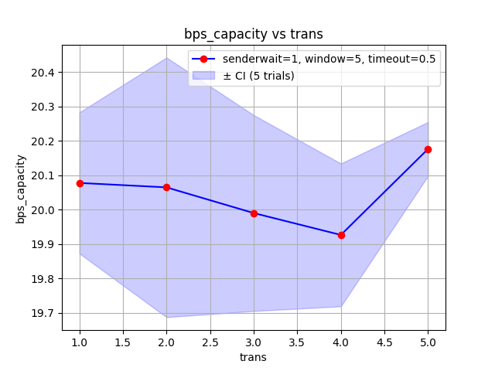
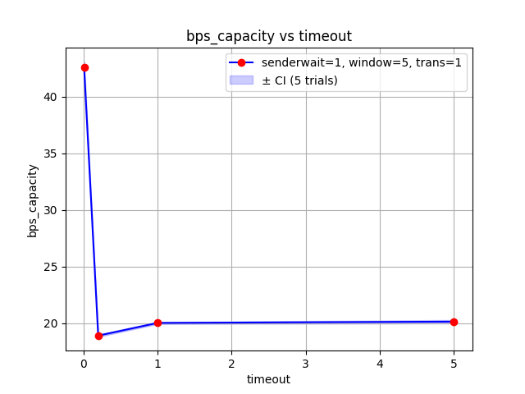
Channel Capacity
Max available capacity, 1 bit per packet
Measured bits per packet and bits per second (bps)
Notes:
When we look at the capacity of this communication,
we know that the maximum achievable capacity is 1 bit per packet.
2- how many covert bits per second is transmitted
With default parameters, this channel achieves around 20 covert bits per second.
Window size increases the capacity significantly with its peak at 45 covert bits per second.
Whereas timeout significantly reduces the capacity as the sender has to wait for ACKs.

Slide 9
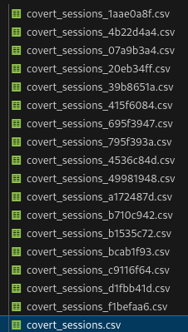
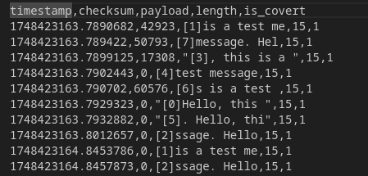
Dataset
Create traffic by selecting phases “covert” and “overt” randomly
0/1 binary classification
Notes:
To employ a machine learning model, we’ll first create a dataset.
We create a traffic by selecting covert and overt phases randomly.
Ground truth labels for each packet as either 1 or 0, indicating
if there is a covert channel or not, binary classification.
We also split the dataset with respect to input parameters to measure accuracy for different experiments.

Slide 10

Channel Detection
Anomaly detection [1]
sec
mitm
insec
XGBoost [2]
Notes:
To detect the covert channel, we’ll use anomaly detection.
To do the anomaly detection, we’ll employ XGBoost model, that is simply, an ensemble of decision trees.

Slide 11
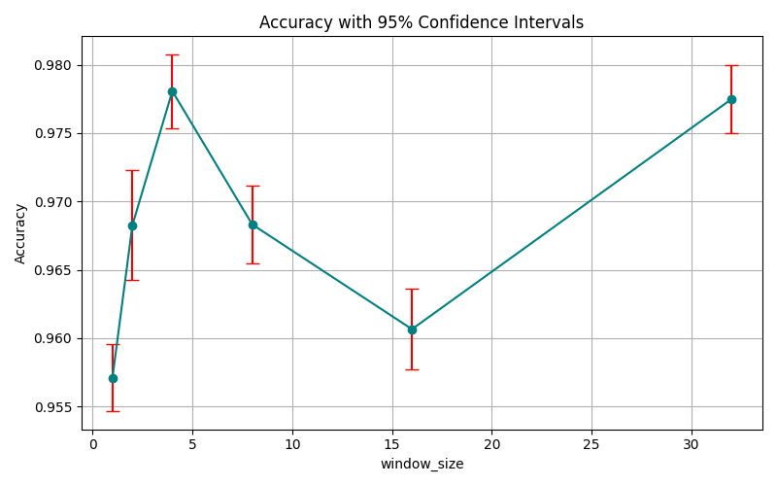
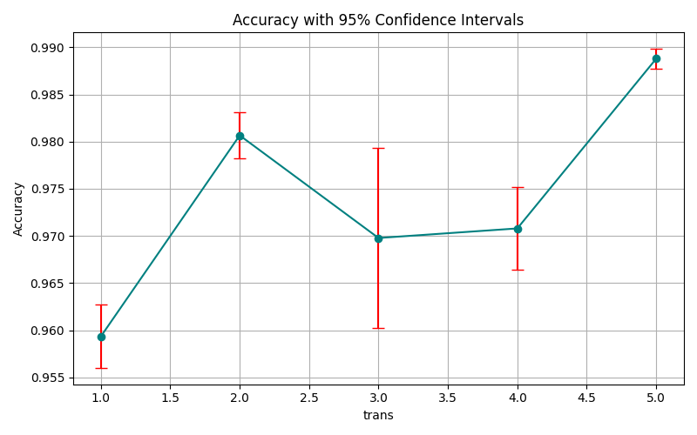
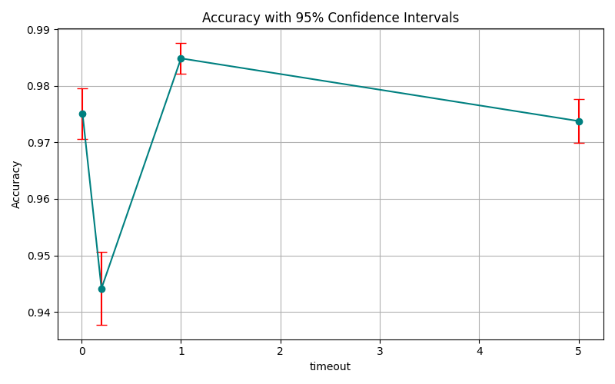
Channel Detection Results
Phase 3 results
92% accuracy on the large dataset
Notes:
When it comes to channel detection
On the largest dataset with randomly chosen covert and overt states, the accuracy is achieved 92%
-> This accuracy increases when the transition between the states are done with a fixed probability of 0.8
which indicates the overt phase effectively lowers the detectability of this channel
Here, detection has the lowest accuracy when the window size is 1
- or when maximum transmission is 1, so more retransmissions making the channel more susceptible to detection
- and when timeout is 0.1, Either having no timeout or a long timeout both makes the channel more detectable
Among all these smaller experiments with different input settings, we observe the accuracy is around 96% on average.

Slide 12
Mitigation
Enforce checksum
sec
mitm
insec
Notes:
To mitigate this covert channel, we’ll enforce correct checksum for each packet.
Alternatively we could drop the checksum for each packet, or even corrupt them
by randomly dropping some, and enforcing checksum in others.

Slide 13
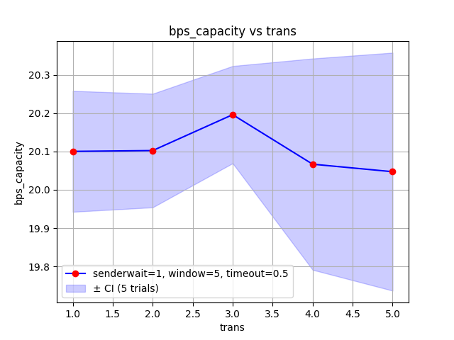
Mitigation Results
Does not cause bottleneck
before
after
Notes:
When we look at the results,
Here the mitigation of this covert channel does not cause a bottleneck in capacity
For default settings, capacity is still around 20 bits per second.
The sender does not know if the covert bit was modified or not,
In mitigation stage, our processor, man in the middle, actually turns all covert bits to 1 by enforcing checksums.
So the channel capacity in terms of Phase 2 implementation is roughly the same, but the covert data itself is corrupted that no covert bits are actually transmitted after mitigation.

Slide 14

Conclusion
UDP Checksum Processor
sec
mitm
insec
Notes:
In summary, we send 1 covert bit per packet by using existence of checksum field.
we used sliding window protocol over UDP for reliability
Then we employ XGBoost for anomaly detection, that achieves more than 90% accuracy.
Then we simply mitigate this channel by always including correct checksum.
which does not have a significant impact on the perceived channel capacity
but still is able to corrupt the transmitted covert data.

Slide 15
References
Thank you.
[1] G. Fisk, M. Fisk, C. Papadopoulos, and J. Neil, “Eliminating steganography in internet traffic with active wardens”, in Information Hiding: 5th International Workshop, IH 2002 Noordwijkerhout, The Netherlands, October 7-9, 2002 Revised Papers 5, Springer, 2003, pp. 18–35.
[2] T. Chen and C. Guestrin, “Xgboost: A scalable tree boosting system”, in Proceedings of the 22nd ACM SIGKDD International Conference on Knowledge Discovery and Data Mining, ACM, 2016, pp. 785–794

